Slide 1
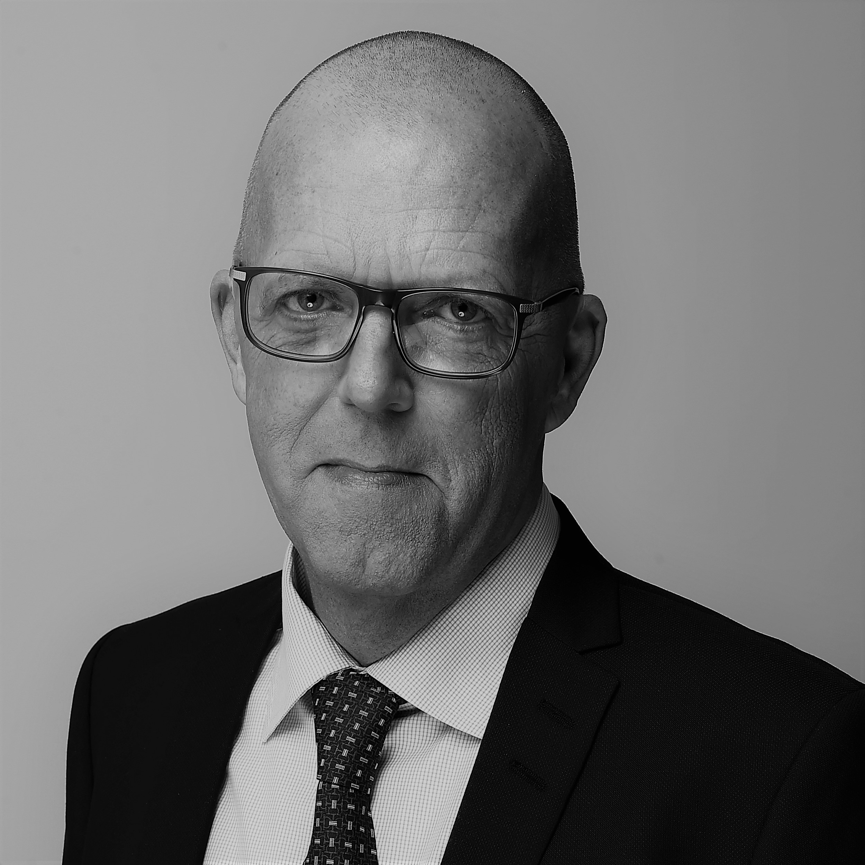
Per W. Hallgren, Chairman
Per Wetke Hallgren – born 1962
Chairman of the Board of CEJ Ejendomsadministration A/S and CEJ Aarhus A/S. Joined on 11 October 2016.
CEO of Jeudan.
Chairman of the Board of CEPOS as well as of subsidiaries 100% owned by Jeudan. Member of the Board of the Erik Fjeldsøe Foundation, Nykredit A/S, Nykredit Realkredit A/S, the Ofelia Plads Association, and the Velkommen Hjem Association.
Chairman of the Risk Committee and member of the Audit Committee in Nykredit A/S and Nykredit Realkredit A/S.
Chairman of DI Ejendom.

