Slide 1
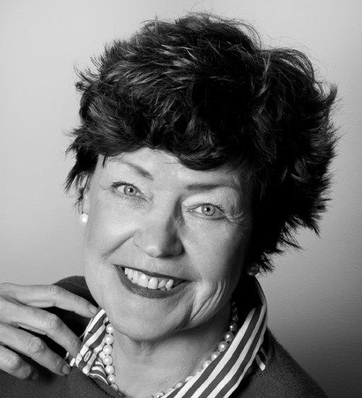
Judy Jakobsen, board member
Judy Jakobsen – born 1955.
Master of Laws, University of Copenhagen – 1981.
Legal Adviser
Chairman of C. E. Jensens Fund, Poeten Poul Sørensen og hustru fru Susanne Sørensens Legat, Tage Larsen Elm og hustru Else Elm Familiefond.
Board member of CEJ Property Management Ltd. and CEJ Aarhus Ltd. og Ltd. Matr.nr. 363 Vestervold kvarter.
Not considered as independent.

