Slide 1
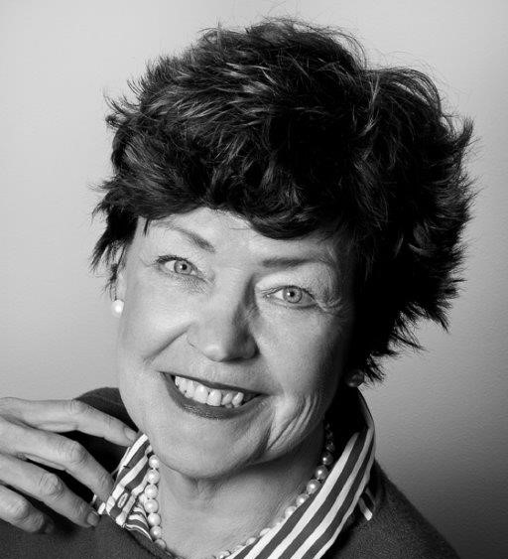
Judy Jakobsen, board member
Judy Jakobsen – born 1955. Master of Laws, University of Copenhagen – 1981.
Legal Adviser
Chairman of C. E. Jensens Fund, NGAC Holding Ltd., Vinhandler V. Bach Hansen og hustrus lånefond, C. C. Klestrup og hustru Henriette Klestrups Mindelegat, Poeten Poul Sørensen og hustru fru Susanne Sørensens Legat, Else Marie og Sigurd Holten-Nielsens Mindelegat, Tage Larsen Elm og hustru Else Elm Familiefond.
Board member of CEJ Property Management Ltd. and CEJ Aarhus Ltd., Have Kommunikation Ltd. og Ltd. Matr.nr. 363 Vestervold kvarter, Liva Fond and associated shipping partnership. Not considered as independent.

