Slide 1
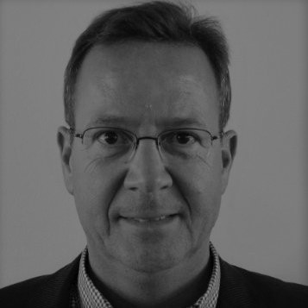
Claus Okholm, board member
Claus Okholm – born 1962.
Certified Public Accountant, partner and owner of the consultancy HC Okholm.
Member of the Board of Directors of CEJ Property Management Ltd., CEJ Aarhus Ltd. and Vestjysk Bank Ltd., Lunar Bank Ltd., Lunar Group Ltd. Entered the Board of Directors on 26 February 2018.

